Slide 1
INVESTMENT ASSIGNMENT SUBMISSION
Amar Parsekar

Slide 2
Investment Strategy Analysis
Company name – Sparks Fund (Asset Management Company)
Business Objectives
Wants to make investment in few companies.
Constraints
Investment range should be in between 5 million and 15 million dollars.
Wants to Invest in only those countries where English is the official language.
Strategy
Investing in sectors and companies where investors from across the world is investing.

Slide 3
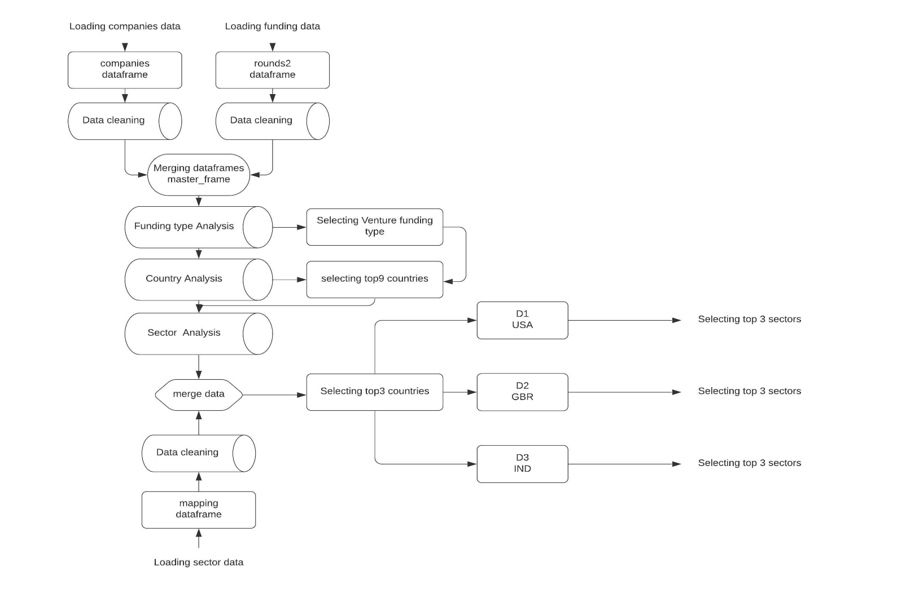
Flow chart

Slide 4
Funding Type Analysis
Average investment across seed, private equity, venture, angle funding
Select only those funding types which have average funding amount between 5 and 15 Million dollars. Which is in our case is Venture funding type.
Venture type | 11,724,220
Angel type | 971,573.90
Seed type | 747,793.70
Private equity type | 73,938,490

Slide 5
Country Analysis
Chart of top9 countries
In top9 countries chart we can that we have only 4 countries which have English as their official language of Communication.
Out of which we will going to select top3 – USA, GBR, IND
Country | Investment | English language
USA | $420,068,000,000 | YES
CHN | $39,338,920,000 | NO
GBR | $20,072,810,000 | YES
IND | $14,261,510,000 | YES
CAN | $9,482,218,000 | YES
FRA | $7,226,851,000 | NO
ISR | $6,854,350,000 | NO
DEU | $6,306,922,000 | NO
JPN | $3,167,647,000 | NO

Slide 6
Sector Analysis
Top performing sectors in top3 countries.
Above chart shows top performing main sectors in each countries (Top 3 English speaking countries)
Country code | Main Sector | Investment
USA | Others | 26,321,010,000
 | Social, Finance, Analytics, Advertising | 23,807,380,000
 | Cleantech / Semiconductors | 21,206,630,000
GBR | Others | 1,283,624,000
 | Cleantech / Semiconductors | 1,150,140,000
 | Social, Finance, Analytics,Advertising | 1,089,404,000
IND | Others | 1,013,410,000
 | Social, Finance, Analytics, | 550,549,600
 | News, Search and Messaging | 433,834,500

Slide 7
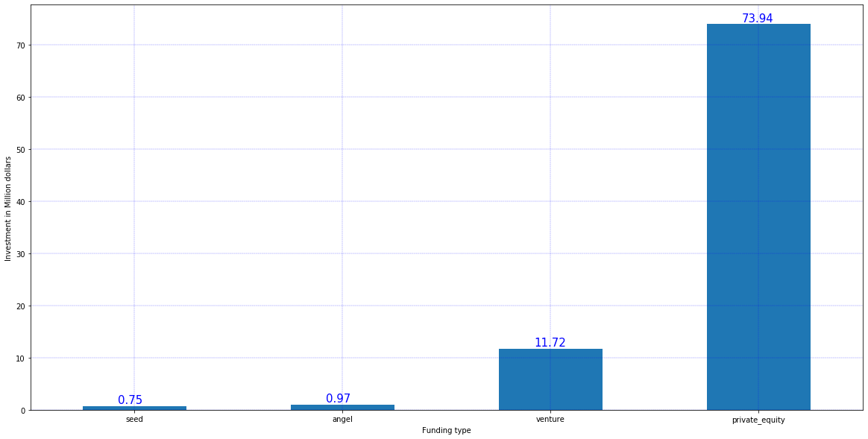
Plot Showing Investment in funding types
Venture lies between
5 and 15 Million $

Slide 8
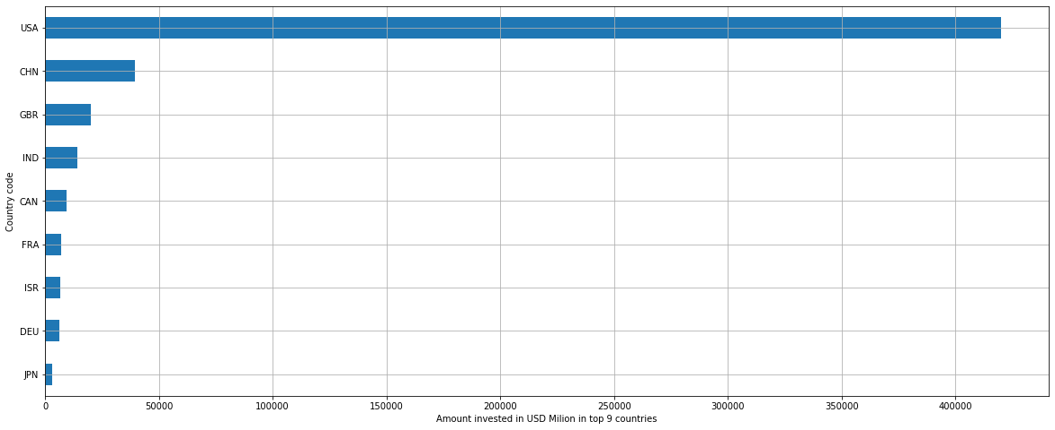
Plot showing Investment in top9 countries

Slide 9
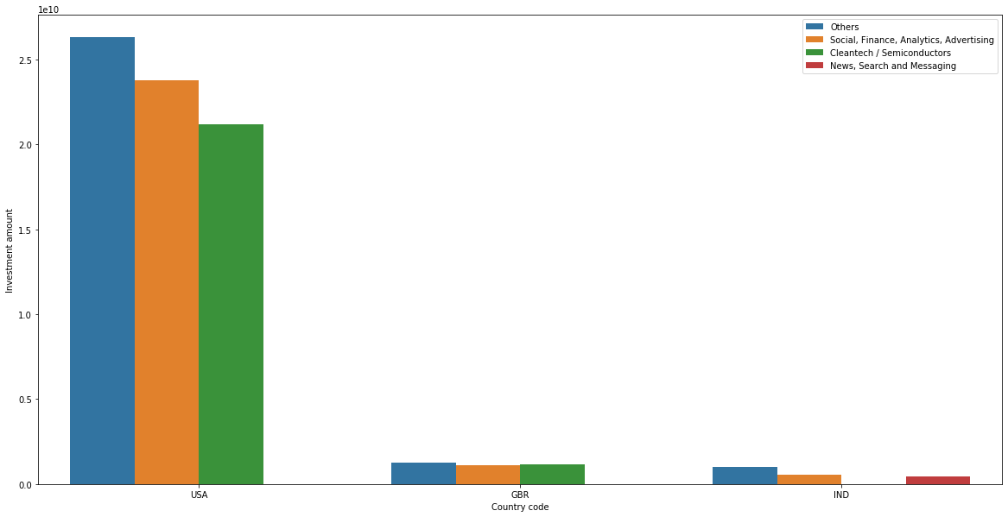
Plot showing performance of main sector in 3 countries

Slide 10
Conclusion
Venture funding type is the most suited option for Sparks fund.
As per business objectives of Sparks fund, they have most favourable opportunity to invest in main sector named Others in United States.
Besides they have two more options to choose from county wise, GBR (United Kingdom) and India.
Others main sector is favourable in both the countries by Investors. Overall as follow –
Funding Type – Venture
Country code | Main Sector
USA | Others
 | Social, Finance, Analytics, Advertising
 | Cleantech / Semiconductors
GBR | Others
 | Cleantech / Semiconductors
 | Social, Finance, Analytics, Advertising
IND | Others
 | Social, Finance, Analytics,Advertising
 | News, Search and Messaging

